Slide 1
Future Value with Compound Interest
Liberal Arts Mathematics

Slide 2
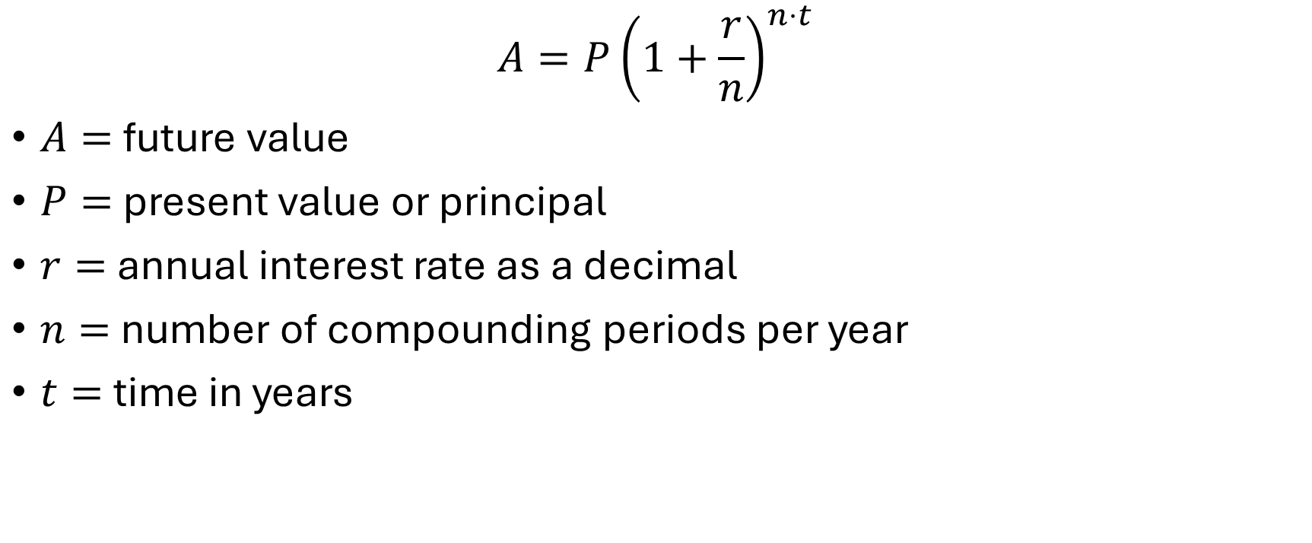
Compound Interest Formula
$$A=P{\left(1+\frac{r}{n}\right)}^{n⋅t}$$
$A=$ future value
$P=$ present value or principal
$r=$ annual interest rate as a decimal
$n=$ number of compounding periods per year
$t=$ time in years

Slide 3
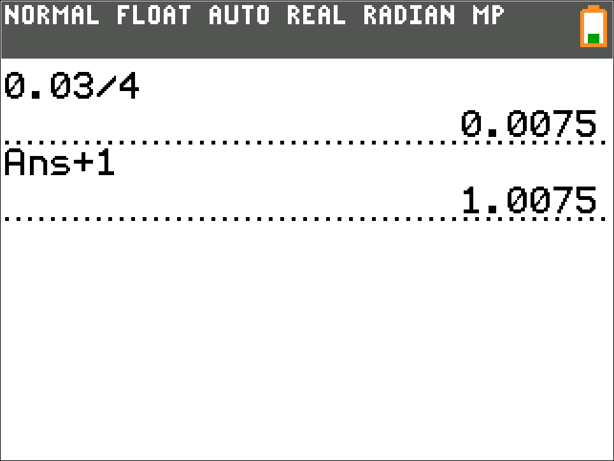
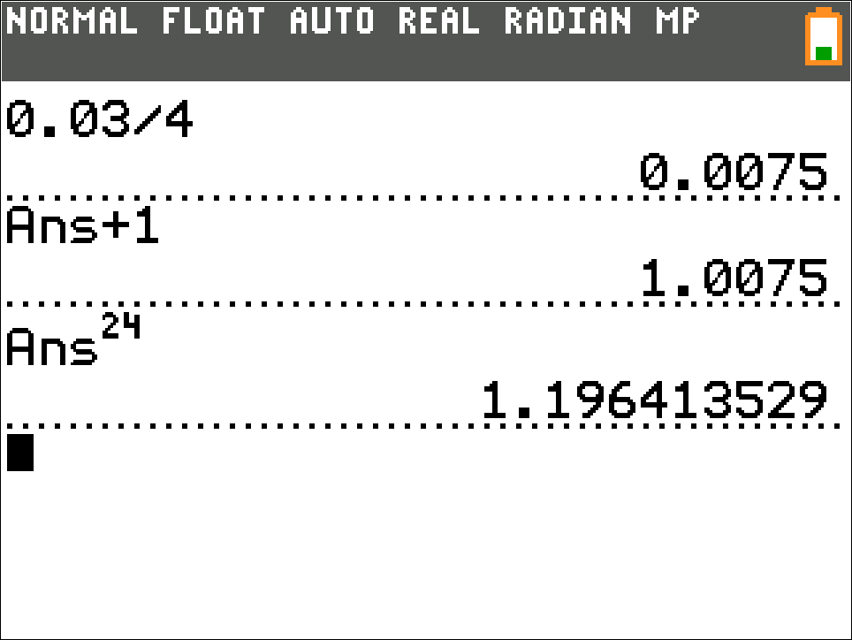
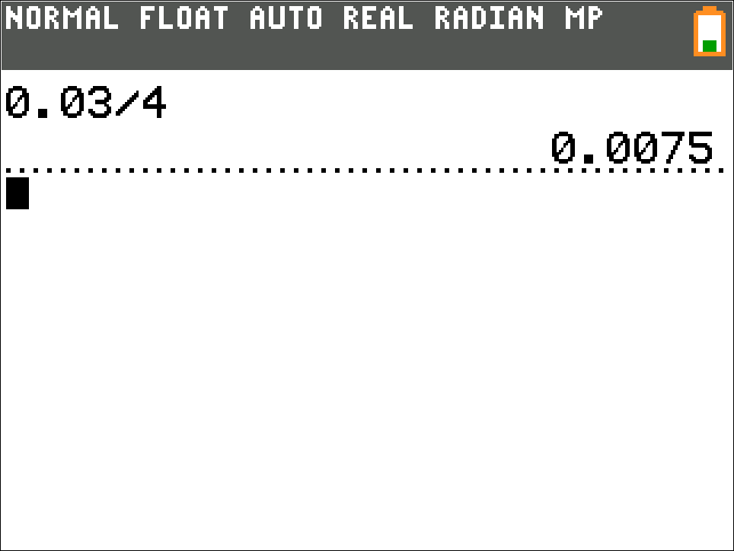
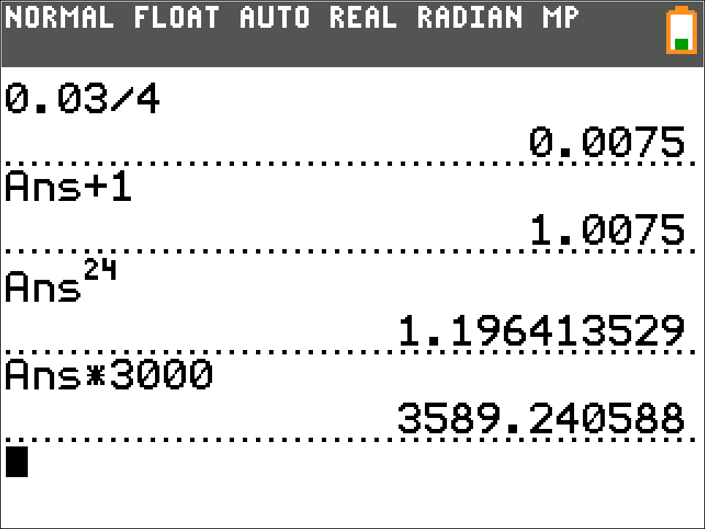
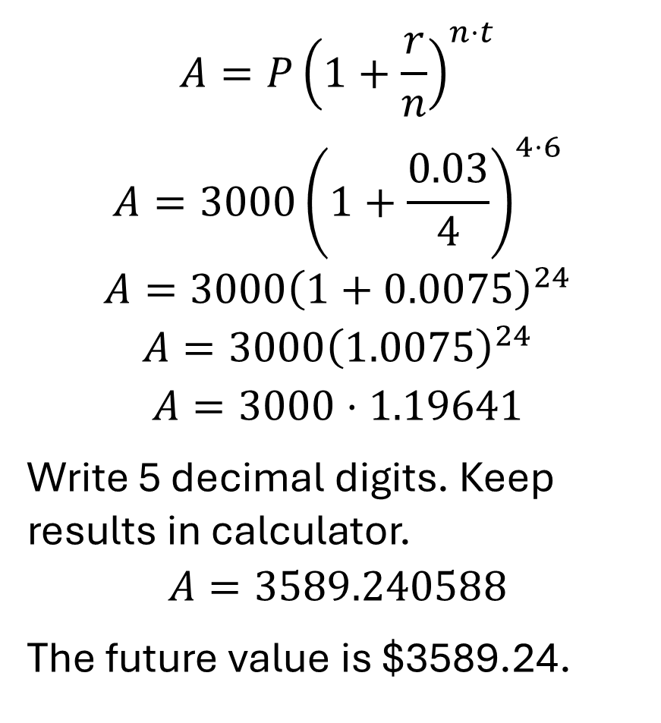
Example 1
$$A=P{\left(1+\frac{r}{n}\right)}^{n⋅t}$$
$$A=3000{\left(1+\frac{0.03}{4}\right)}^{4⋅6}$$
$$A=3000{\left(1+0.0075\right)}^{24}$$
$$A=3000{\left(1.0075\right)}^{24}$$
$$A=3000⋅1.19641$$
Write 5 decimal digits. Keep results in calculator.
$$A=3589.240588$$
The future value is $3589.24.
Calculate the future value of an account with compound interest. The principal is $3000, the annual interest rate is 3%, compounding is quarterly, and the term is 4 years.

